Slide 1
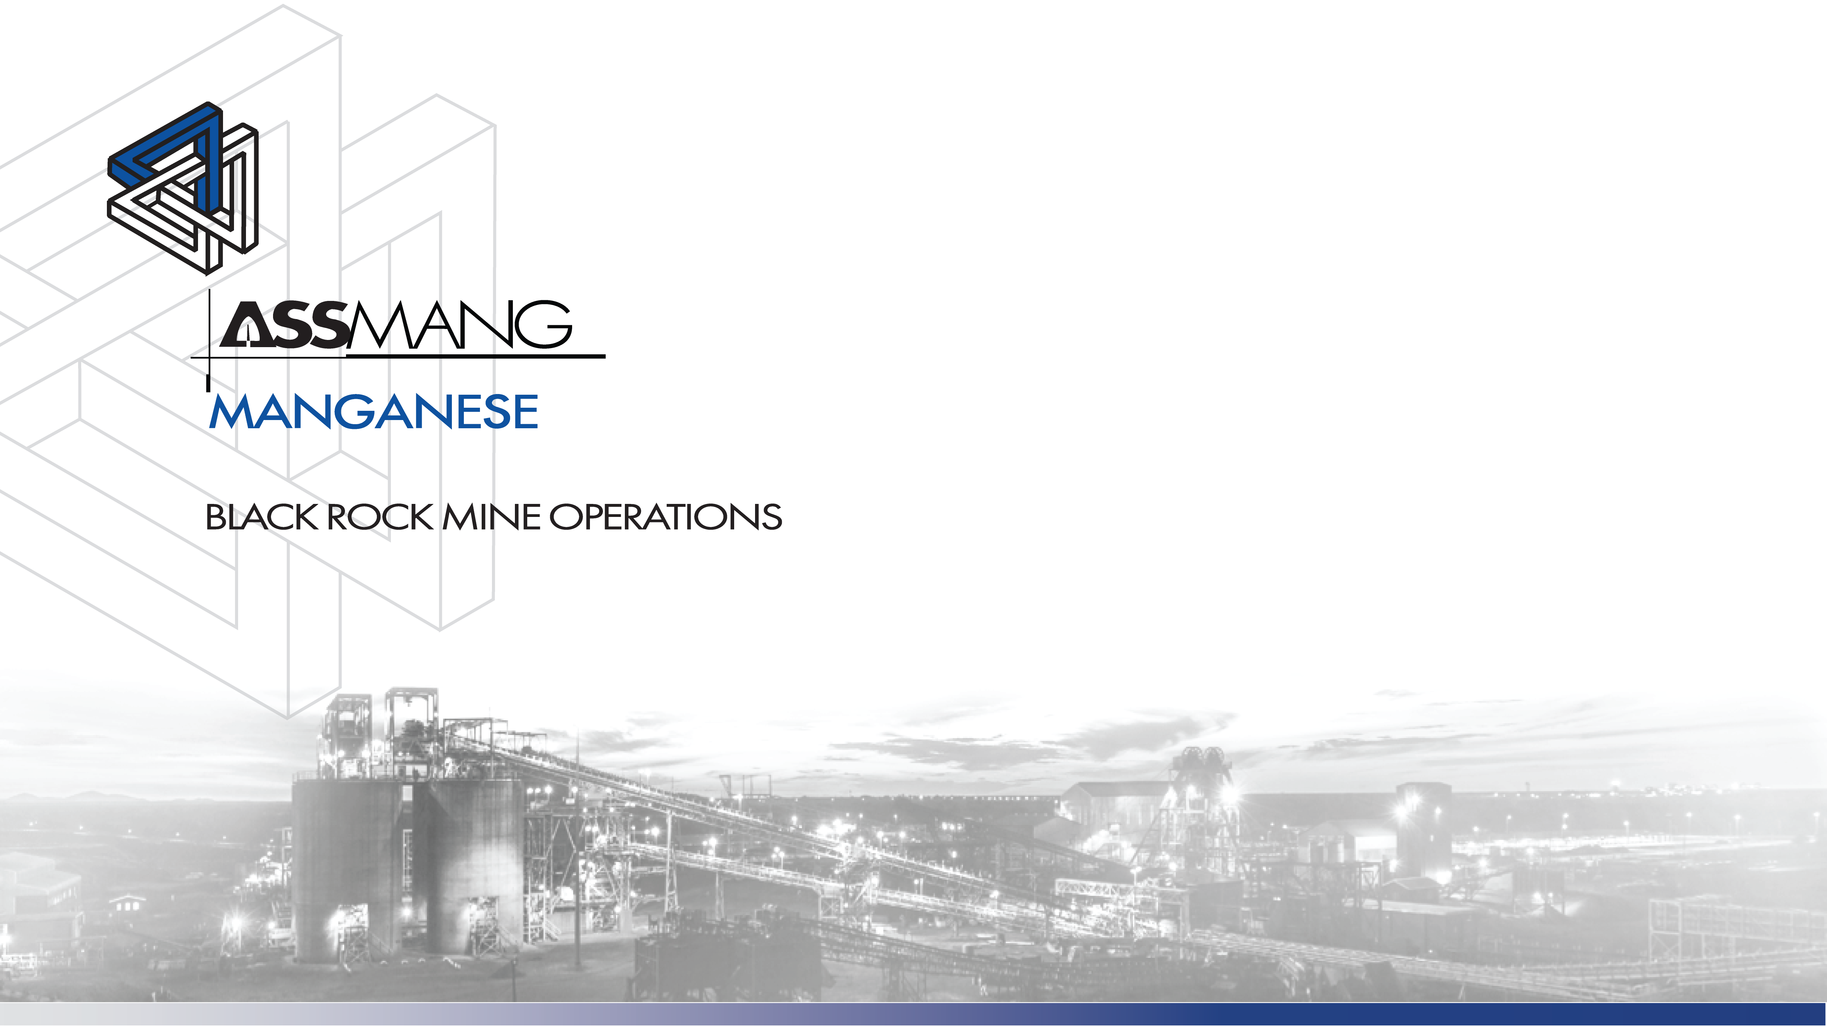
Presentation to the Principal Inspector of Mines
CPS Implementation and Compliance at BRMO
16 October 2025

Slide 2
Agenda
Introductions
Overview
Status Update
Risks and Challenges
The Way Forward

Slide 3
Overview

Slide 4
CPS Project Implementation | Overview
Highlights: Well-thought implementation project approach. Human Change Management: Crucial for successful CAS Level 9 implementation. Careful selection of technology partners. Successful CxD changeover (Booyco to Strata). Intelligent Lamproom: Excellent data feedback loop. Testing & Operating Criteria: Adopted into Minerals Council CPS guidelines. Traffic Flow Analysis & Risk Management: Fully implemented and effective. All underground high risk TMM (DT and FL) fully Lev 9 compliant by Nov 2025. On track for full Lev 9 compliance by Dec 2025 (as per commitment to DMPR). BRMO Leadership: National benchmark for Level 9 integration. | Lowlights: Delays: Due to tech and skills shortages. ISO 21815-2:2021 Interpretation: OEMs vary in compliance and interpretation. CAS Provider Limitations: No provider meets 100% of requirements. Surface CAS Compliance Issues: Some solutions not meeting regulations.
Emerging Issues: IT Architecture & Data Flow: Overloaded networks, complex reporting. OEM Non-Compliance: Bell, BWE/Cat not yet meeting FTSWHI requirements. EMI (Electromagnetic Interference) Present on Machines : Affecting Operation and Crawling distances. Section 21, NRTA complications for road vehicles. | Priorities: Data Flow Optimization: Reducing unnecessary data transmission. Standards Feedback: Preparing submissions to authorities. Compliance Testing: University of Pretoria involvement. Industry Alignment: Active role in Minerals Council task teams. Supplier Performance: Pressure on Strata and others to comply. Alternative Solutions: Exploring new suppliers and legal compliance routes. Skills Development: Recruiting and training on new tech. Firmware Upgrades: Ongoing improvements by suppliers. EMI Investigation: Scheduled testing with Interference Testing and Consultancy Services.

Slide 5



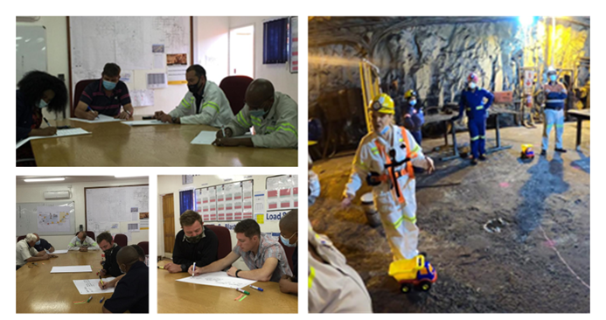
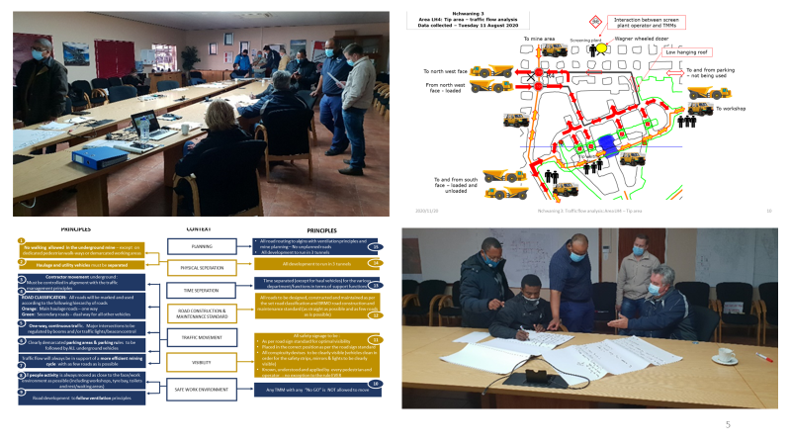

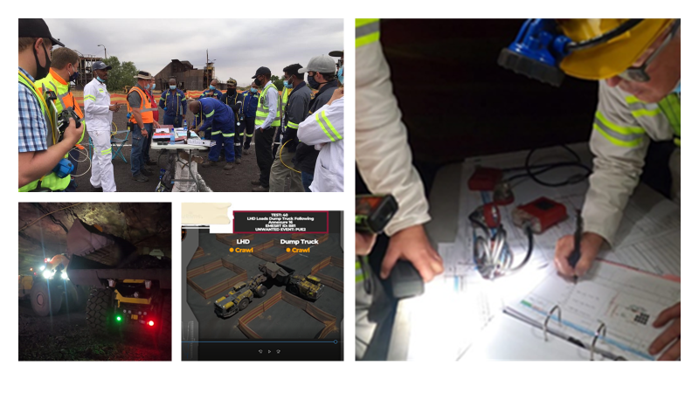
CPS Project Implementation | Approach
Collision Prevention is an eco system
SAFE ROADS
Review, alignment (CAS level 9 impact), and implementation of the traffic management flow and plan
Review high risk areas in the context of CAS level 9 implementation – Traffic management plan 2.0
Implementation of traffic management plan
SAFE PEOPLE
Human behavior: Establish foundational base of CAS technology acceptance and operational safety (CAS & BEVs)
SAFE VEHICLES
CPS/CAS technology installation

Slide 6
Status Update

Slide 7
Process Flow Towards TMM Regulations Compliance
User requirement specification
CAPEX approved.
Traffic flow analysis.
Risk assessment is in place and has been implemented.
Traffic management plan (TMP) in place.
Functional specifications compiled for CxD providers and OEMs.
Human change management program designed, implemented and supports the CPS project daily.
Detailed CxD technology selection process has been completed.
A detailed CPS testing procedure developed, and CAPEX raised to perform the testing.
CPS testing done against detailed acceptance criteria.
New CxD technology selected.
CxD and OEM orders and contracts, SLAs in place.
Information technology systems upgraded for reporting and integrated into business model.
Reports for detailed interaction analysis and actions taken.
Skills readiness and knowledge transfer for installation, repair, and maintenance.
Induction and Training.
Implementation plan in place for roll out to the remaining operations.

Slide 8

CPS L9 Installation | Status Update | High Risk FL and DT
8

Slide 9
CPS L9 Installation | Status Update | Total Fleet

Slide 10
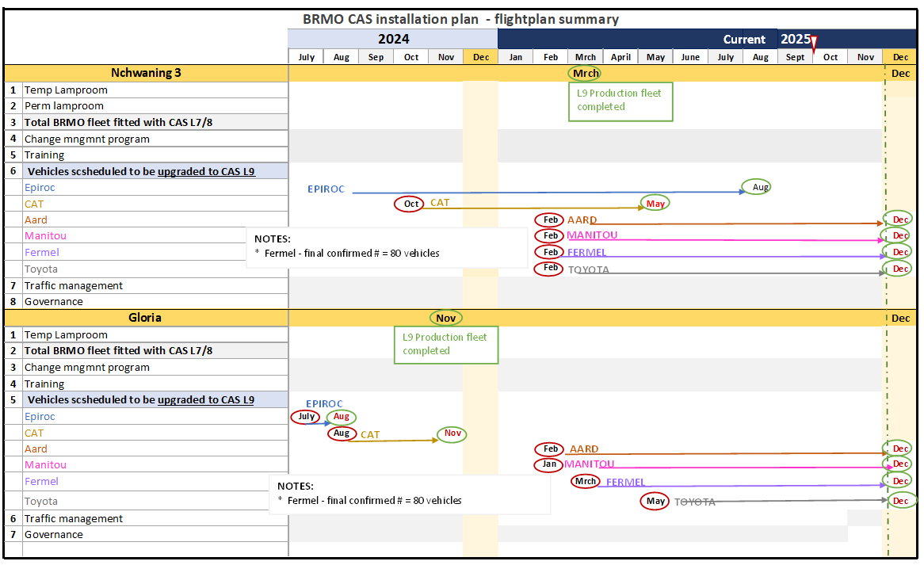
Installation Schedule | Nchwaning 3 & Gloria

Slide 11
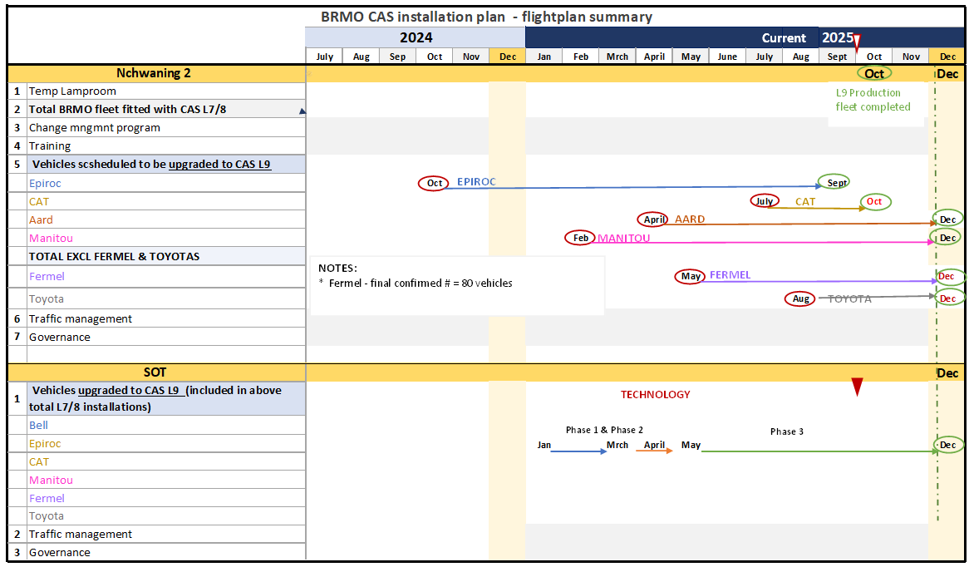
Installation Schedule | Nchwaning 2 & SOT

Slide 12
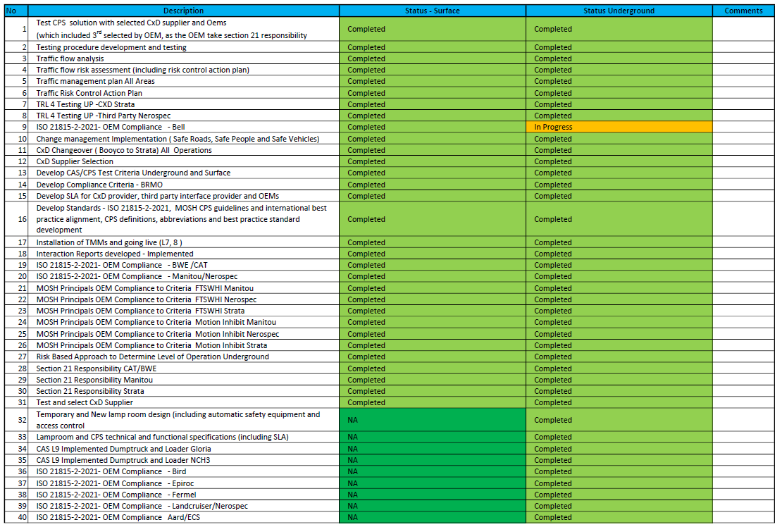
CPS Program | Detailed Progress

Slide 13
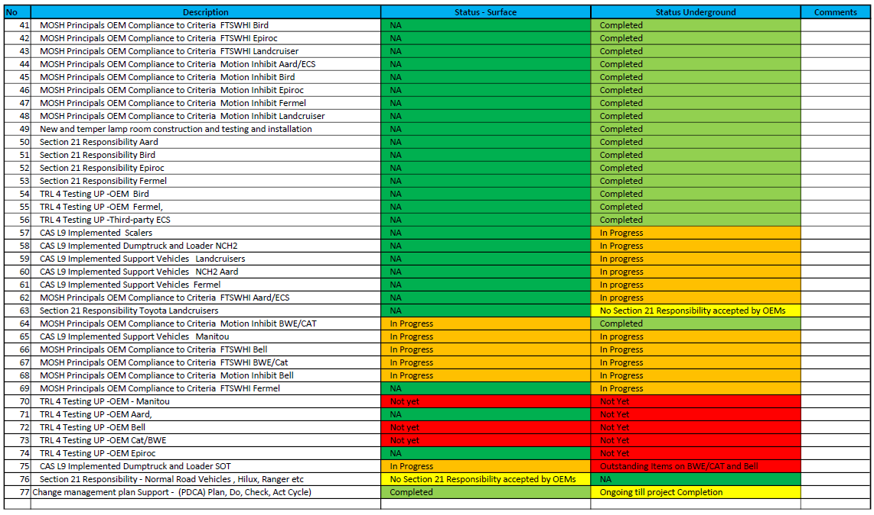
CPS Program | Detailed Progress

Slide 14
Risk and Challenges

Slide 15
Risk and Challenges
# | Risk/Challenge | Mitigation/Action
1 | BWE/CAT OEM Compliance to Fail To Safe Without Human Intervention (FTSWHI) Risk : In the event of a FTSWHI failure and CANBUS communication loss, the machine automatically diverts to L7 mode. | CAS L9 can be activated on the machine. However, activation must be conditional upon the following: Conduct HAZOP: To identify and address all induced and initiated risks associated with CAS L9 functionality. Implement Interim Safety Measures
2 | BWE/CAT OEM Compliance to Fail To Safe Without Human Intervention (FTSWHI) Risk: The machine resumes normal operation automatically after a fault or event is cleared, without requiring a product specialist to declare it safe. | CAS L9 can be activated on the machine. However, activation must be conditional upon the following: Conduct HAZOP: To identify and address all induced and initiated risks associated with CAS L9 functionality. Implement Interim Safety Measures
3 | BWE/CAT OEM –Machine does not Motion Inhibit: After the machine stops due to a CxD instruction or a FTSWHI event, motion inhibit is not active, allowing potential unintended movement. | CAS L9 can be activated on the machine. However, activation must be conditional upon the following: Conduct HAZOP: To identify and address all induced and initiated risks associated with CAS L9 functionality. Implement Interim Safety Measures
4 | Bell Trucks OEM Compliance to Fail To Safe Without Humen Intervention ( FTSWHI) Risk: The machine does not support a controlled stop. Instead, it performs an emergency stop, applies brakes, and shuts down the engine immediately—bypassing the standard 4-step safety process: Step 1 – Initiator Step 2 – Bring vehicle to a safe stop Step 3 – Safepark Step 4 – Reactivation process | CAS L9 can be activated on the machine. However, activation must be conditional upon the following: Conduct HAZOP: To identify and address all induced and initiated risks associated with CAS L9 functionality. Implement Interim Safety Measures
@Hennie, please list the specific risk that might cause us to miss the Dec 2025 target.
E.g. CAT, Bell, OEM support and resource availability, etc.

Slide 16
Risk and Challenges
# | Risk/Challenge | Mitigation/Action
5 | Resource Availability: Availability of skilled resources for both installation/activation and maintenance activities. | CxD and OEM supplier resources to be increased for the installation and activation period , as the issues will increase as more equipment come online
6 | Availability of critical equipment and spare parts required for operational continuity, maintenance, and emergency response. | Stores process and availability of equipment at the installation, activation site
7 | Installation activation and COC standards : Meeting set standards on activation for the system or machine in question | Change-management , audits and corrective action
8 | Machine and Operator availability to do Tests, COC and signoff. | Dedicated responsible person per area to ensure availability of equipment and operators
9 | EMI ( Electromagnetic Interference) , Risk as it may interfere with CPS Equipment | Installation standards adhere to and tests to be conducted when EMI is picked up.
10 | Increase in technical and operational issues as the activation levels increase. | Investigate and address new technical issues as they arise.
11 | Resistance to change and accepting the CPS system. | Change-management sessions to be intensified during the activation process and thereafter.

Slide 17
The Way Forward

Slide 18
Immediate Next Steps
# | Action | By Who | By When
1 | Securing OEM Resources on site. | H van Niekerk | 31 Oct 2025
2 | Complete LDV alternator upgrades. | H van Niekerk | 15 Dec 2025
3 | Feedback from BELL and CAT/BWE. | H van Niekerk / M Bester | 31 Oct 2025
4 | Continuous Change Management. | H van Niekerk | Ongoing
5 | SIC and Weekly project tracking meetings. | G Karsten | Ongoing
6 | Recruit additional resources to assist with project coordination on site. | G Karsten | 1 Nov 2025

Slide 20
Backup Information

Slide 21
CPS Project Implementation | Risk Based Scope
TMM CAS/CPS Application Level
Machine Type | V-V Underground | V-P Underground | V-V SOT | V-P Surface
Dump truck | Level 9 Crawl | Level 9 Stop | Level 9 Stop | Separation -
LHD | Level 9 Crawl | Level 9 Stop | Level 9 Stop | Separation -
Grader | Level 9 Crawl | Level 9 Stop | Level 9 Stop | Separation -
Dozer | Level 9 Crawl | Level 9 Stop | Level 7 | Separation -
LD ( Landcruisers and Fermel) | Level 9 Crawl | Level 9 Stop | NA | NA
Manitou | Level 9 Crawl | Level 9 Stop | Level 9 Stop | Separation -
Scaler | Level 9 Crawl | Level 9 Stop | NA | NA
Bobcat | Level 7 | Level 7 | Level 7 | Separation -
UV ( Landcruisers and Fermel) | Level 9 Crawl | Level 9 Stop | NA | NA
Drill | Level 7 | Level 7 | NA | NA
Roofbolters | Level 7 | Level 7 | NA | NA
Excavator | NA | NA | Level 7 | Separation -
Emergency Vehicles | None | None | None | None
Proto Landcruiser | Level 7 | Level 7 | NA | NA
LDV - Road Transport - Normal Toyota Road Vehicles Services | NA | NA | Level 7 - Separation | Separation -
Delivery and Road Trucks | NA | NA | Level 7 | Separation -
Interaction between Underground and Surface Machines on Surface | Underground Machines will Stop Surface machines during interaction, Underground machines will not Detect Surface Machines
@Hennie, we need to be able to articulate why the Bolters and Drill rigs are only Lev 7/8.
21

Slide 22
CPS Project Implementation | Risk Based Scope | Drill Rigs
Suggested controls to reduce the risk further, whenever necessary.
For all operation purposes effective warning CPS must be installed. (Level 7 & 8) • Safe park to include articulation and boom lock. • Crawl speed is 3 km/hr. • Maximum speed is <12,5 km/hr • Speed in workshop to be crawl speed. • CPS error is a "No-Go". • Braking system testing is critical to ensuring safe stopping of machine. • TMM must act as a beacon when stopped in "unsafe area". • Effective isolation zones to avoid nuisance alarms to be installed. • TMM must be fitted with CPS effective warning, level 7 and level 8 only.
Note: Should drill not be fitted with: pedestrian detection devices that prevent the pedestrian being entangled in drill rotation or movement - stop machine hydraulics automatically should pedestrian walk into "danger zone" while drilling - TMM must be fitted with CPS effective warning, auto retard and auto stop. (level 9) - must be risk assessed for control confirmation as many such incidents have occurred in SAMI.

Slide 23
CPS Project Implementation | Risk Based Scope | Bolters
Suggested controls to reduce the risk further, whenever necessary:
• Although the current risk is low, pedestrian warning is deemed necessary and therefore the Roofbolter to be fitted with CPS effective warning and not auto retard and auto stop.

Slide 24
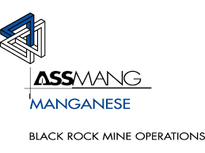
Background support
Extract from ISO 21815-1:2022: “Collision warning and avoidance systems are developing technologies and algorithms are not yet mature and well understood. This document is intended to foster innovation and accelerate the pace of improvements in new collision warning and avoidance technologies.”
CMEIG, EMESRT and ICMM have recognised the need for a guide to the approach for functional safety for mobile earthmoving machinery and provide guidance for the interim approach to non-deterministic systems whilst standards for these are being developed. The standards under development are the ISO 19014 series.
The functional safety approach is to ensure that the integrity of a control system is commensurate with the level of risk posed should that control system fail. It deals with machine controls that work in conjunction with administrative controls to reduce the overall risk to a tolerable level.
Extract from the CMEIG, EMESRT and ICMM: White Paper and Guiding Principles - Functional Safety for Earthmoving Machinery - 05/03/2020:
“The ISO 19014 series, when published, will be the most applicable and appropriate standard for functional safety requirements for deterministic aspects of earthmoving machines and systems. However, note that there may be some retrospectivity considerations as OEMs transition from existing standards such as ISO 13849.”
“The increase in the level of automation of earthmoving machinery (e.g. autonomous haul trucks, collision avoidance systems) has led to the introduction of non-deterministic systems which cannot be analysed using traditional (or established) functional safety methodologies. There are standards under development to address this, however in the interim, a risk-based approach is recommended.”

Slide 25
Our collaborative effort
“Collision warning and avoidance systems are developing technologies and algorithms are not yet mature and well understood.
“There are standards under development to address this, however in the interim, a risk-based approach is recommended.”
“Our experience has found that the above statements are accurate and that we must work closely with CPS suppliers (CxD, Interface Service providers and TMM OEMs) to ensure compliance even though the current state of the CPS technology is immature and the TMMs are not yet designed according to functional safety standards.”

Slide 26
The Act” Section 21. Manufacturer's and supplier's duty for health and safety.
“The Act” Section 21. Manufacturer's and supplier's duty for health and safety.
(1) Any person who -
(a) designs, manufactures, repairs, imports, or supplies any article for use at a mine must ensure, as far as reasonably practicable -
(i) that the article is safe and without risk to health and safety when used properly; and
(ii) that it complies with all the requirements in terms of this Act.
(b) erects or installs any article for use at a mine must ensure, as far as reasonably practicable, that nothing about the manner in which it is erected or installed makes it unsafe or creates a risk to health and safety when used properly; or
(c) designs, manufactures, erects, or installs any article for use at a mine must ensure, as far as reasonably practicable, that ergonomic principles are considered and implemented during design, manufacture, erection, or installation.
(2) Any person who bears a duty in terms of subsection (1) is relieved of that duty to the extent that is reasonable in the circumstances, if -
(a) that person designs, manufactures, repairs, imports, or supplies an article for or to another person; and
(b) that other person provides a written undertaking to take specified steps sufficient to ensure, as far as reasonably practicable, that the article will be safe and without risk to health and safety when used properly and that it complies with all prescribed requirements.

Slide 27
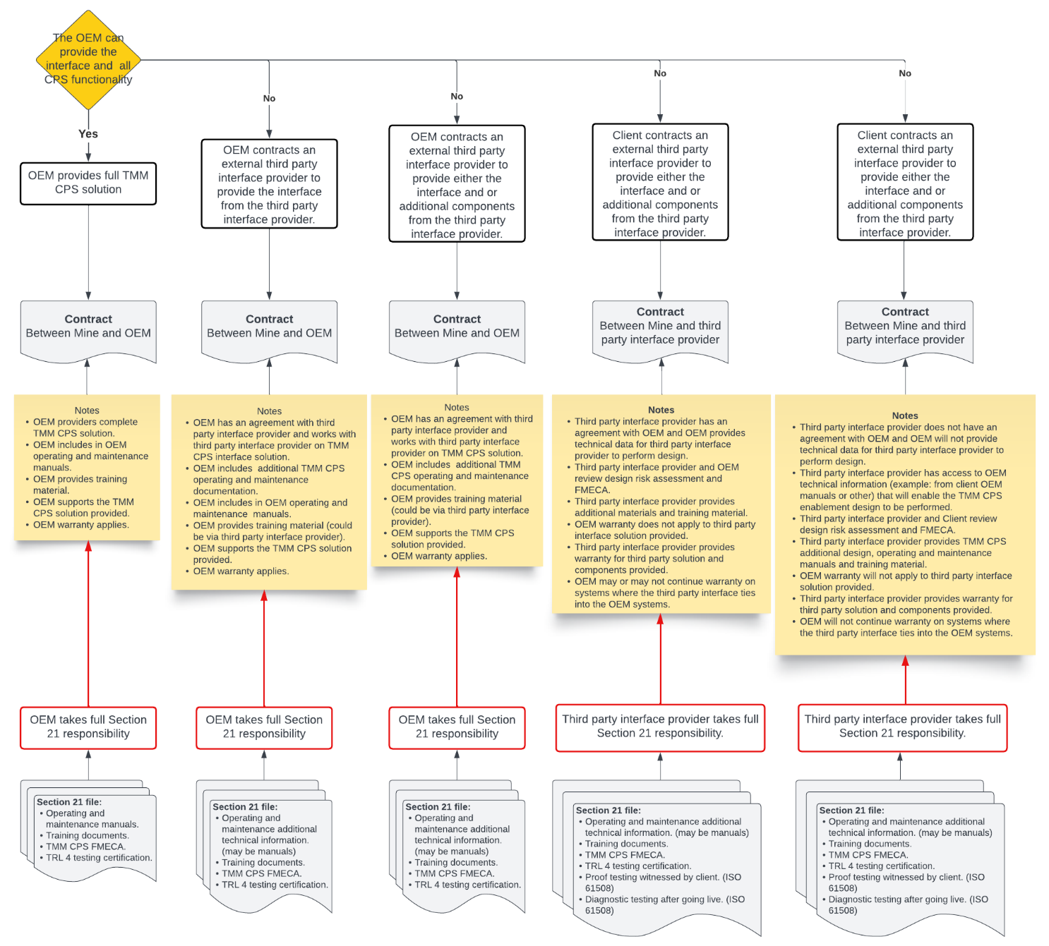
Our approach #3:
Section 21 responsibility

Slide 28
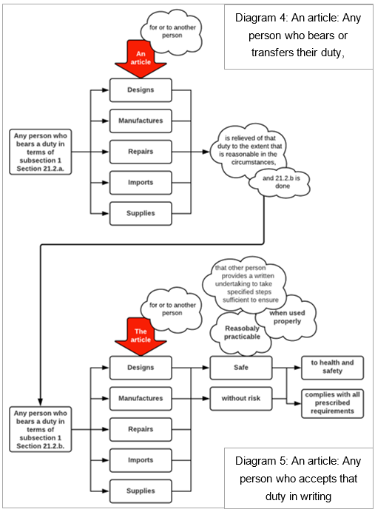
The Act” Section 21. Manufacturer's and supplier's duty for health and safety.

Slide 29
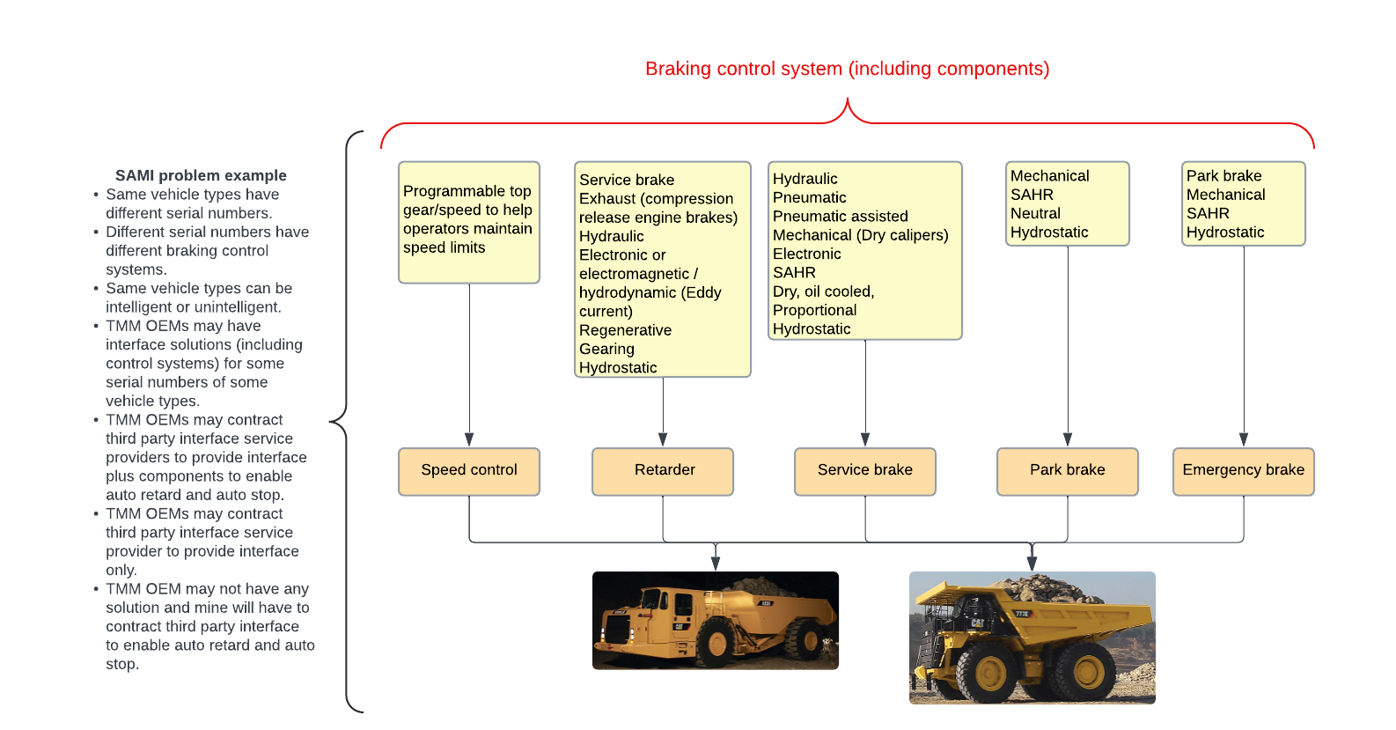


Example: braking systems

Slide 30
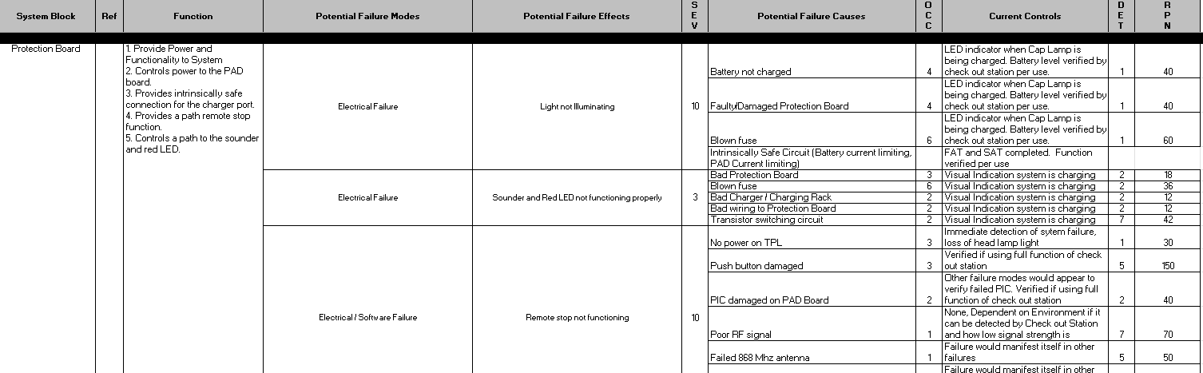
Our approach #5:
Review of FMECA
Example of a portion of a cap lamp FMECA

Slide 31
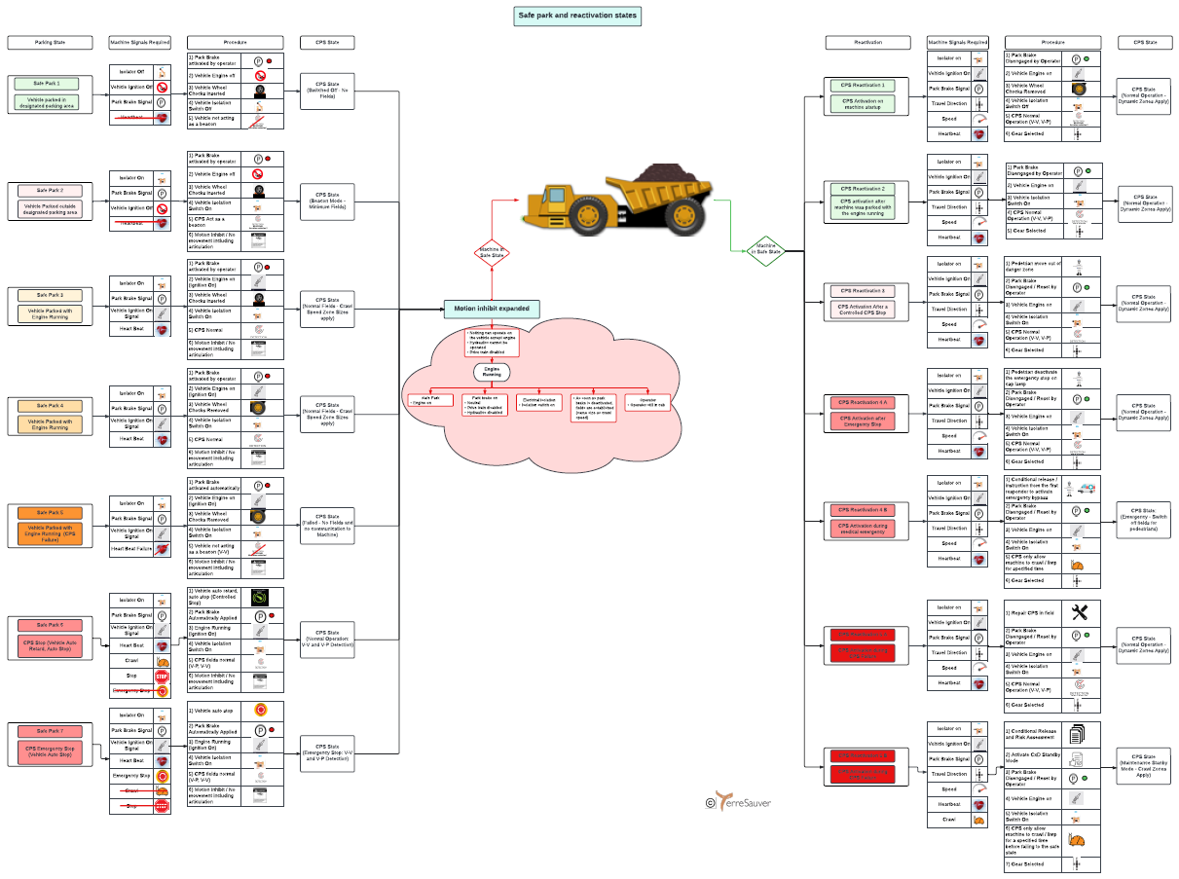
Our approach #6:
Definitions: the “practicalisation” of fail to safe states 3 and 4
Fail to safe states:
Initiator (FMECA determined).
Process (once initiated).
End state.
Re-enablement state.
Note: each state has its own technical complexities which also varies between OEM, TMM type, interface and CxD.
3. End state:
Safe park
4. Re-enablement state:

Slide 32
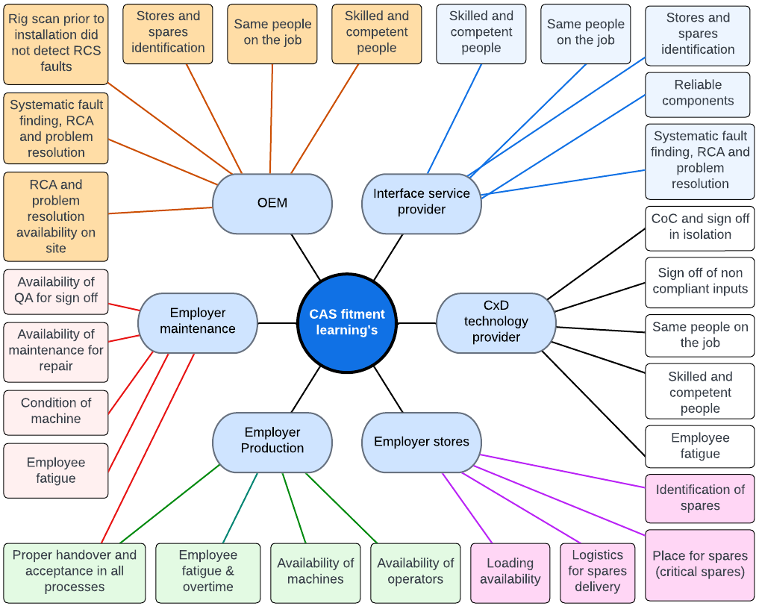

Summary and conclusions – time to fit a vehicle
4
8
4
2
1
1
2
9
7
7
7
6
It takes 5 days to fit, test and commission a TMM
6
6
2
5
1
8
3
3
4
6
3
5
5
6
6
6
32

Slide 33
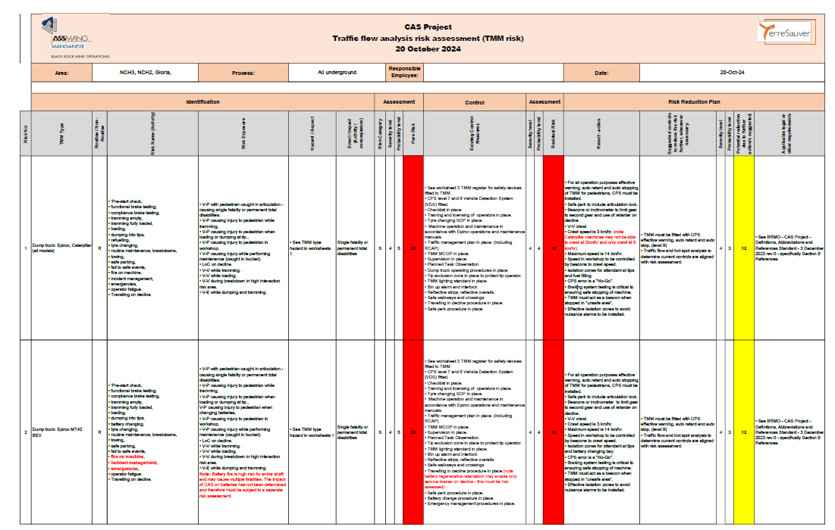
Issue Based Risk Assessment
33

Slide 34
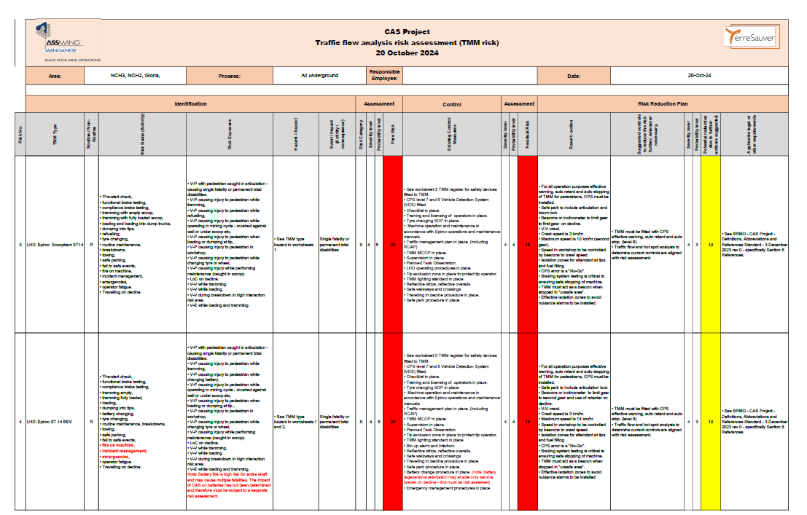
Issue Based Risk Assessment
34

Slide 35
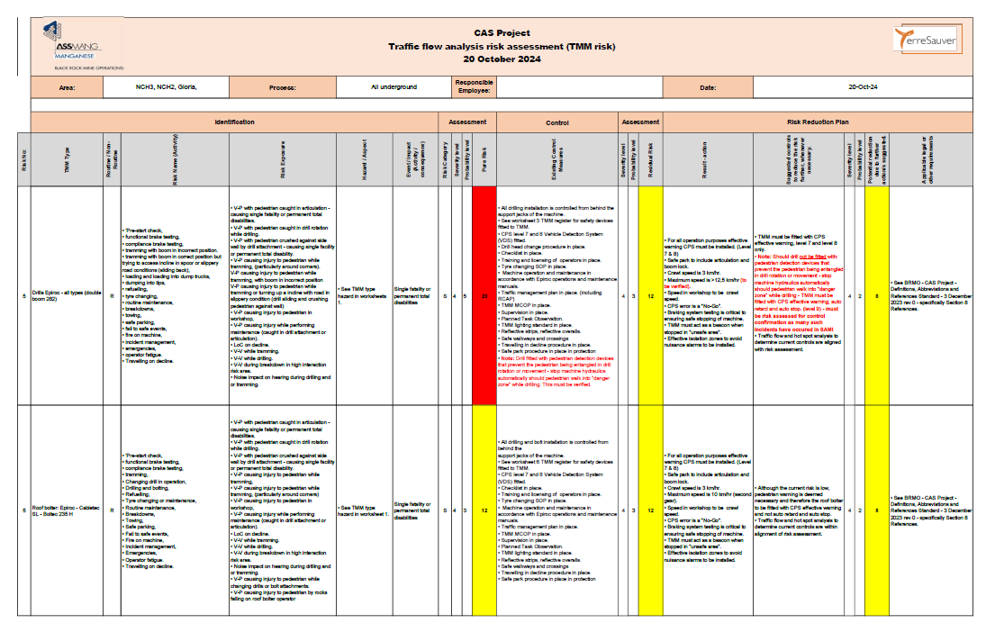
Issue Based Risk Assessment
35

Slide 36
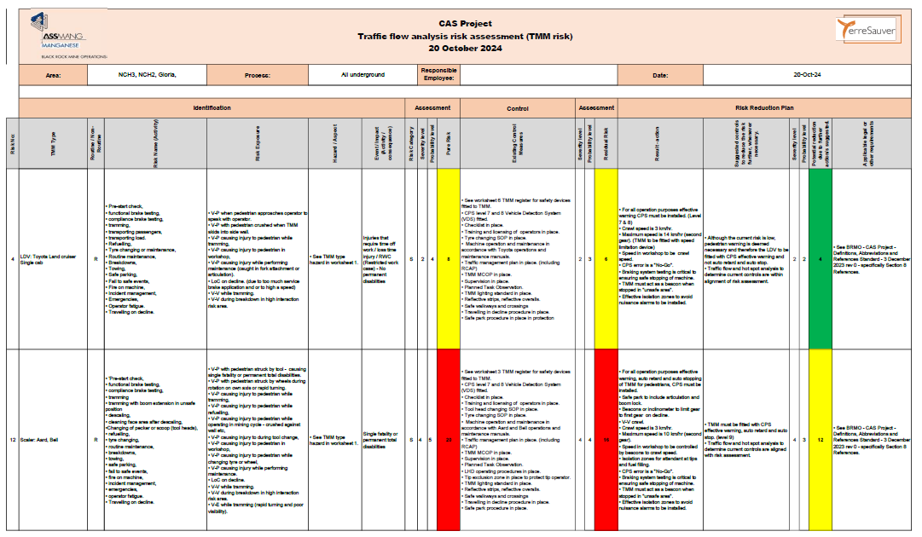
Issue Based Risk Assessment
36

Slide 37
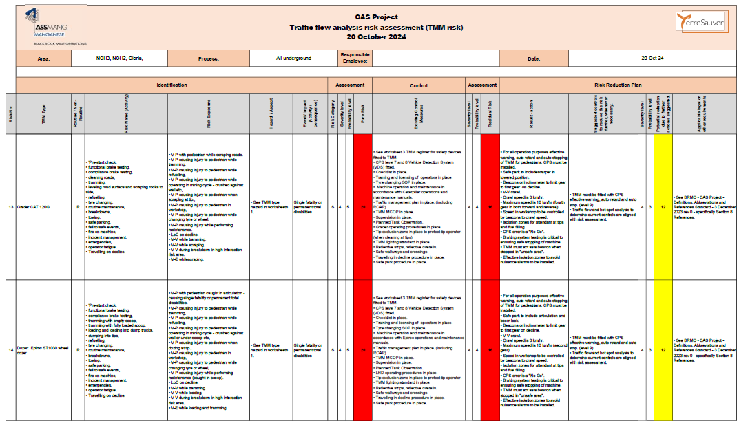
Issue Based Risk Assessment
37

Slide 38
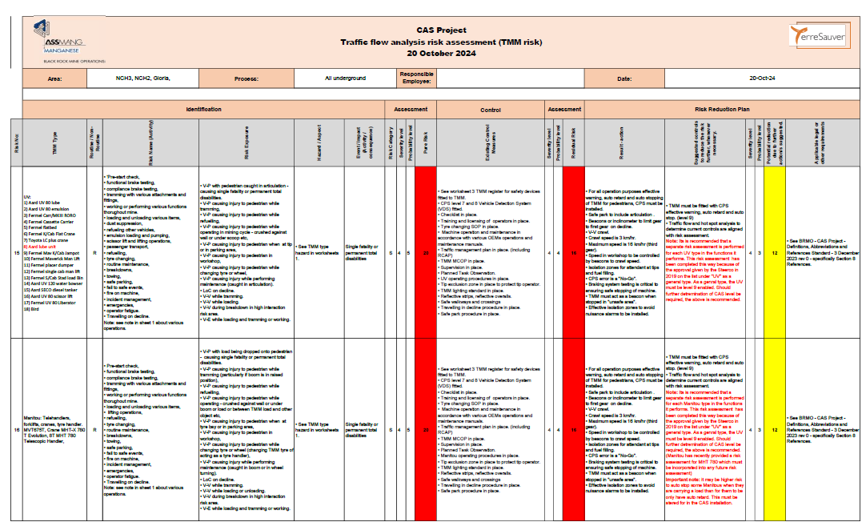
Issue Based Risk Assessment
38

Slide 39
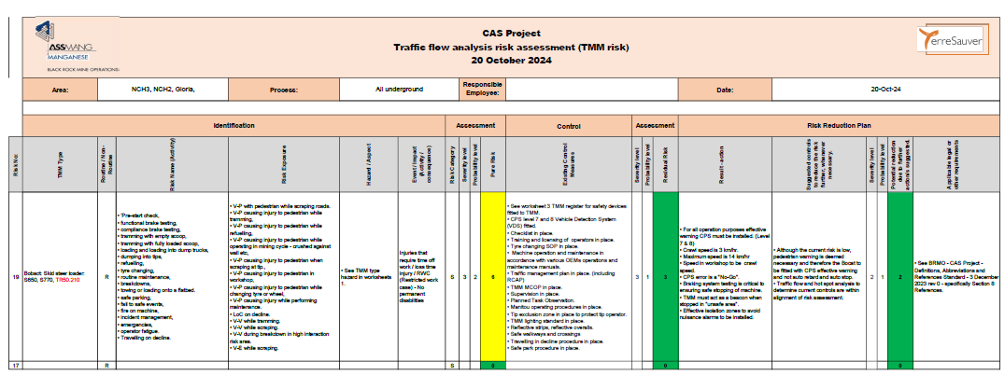
Issue Based Risk Assessment
39

Slide 40
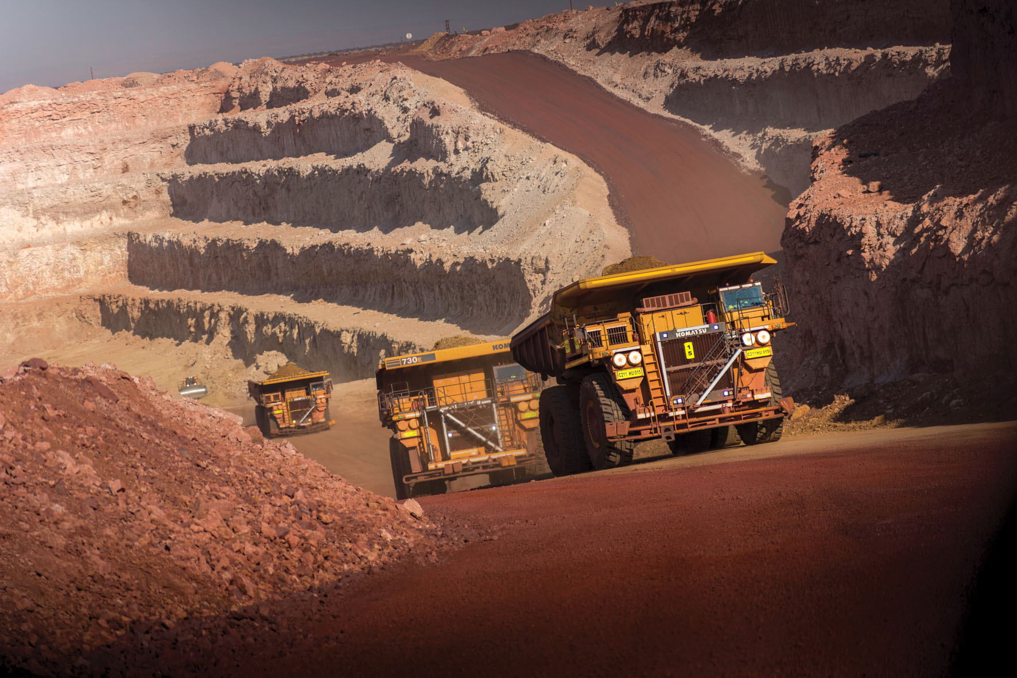



THE ISSUE OF SIGNIFICANT RISK OF TMM COLLISIONS

Slide 41
Why is it an issue?
Mines don’t want to install CPS on all TMMs?
Mines want to leverage the EMESRT approach to justify their CPS strategy?
Mines don’t want to introduce other controls to reduce significant risk of TMM collisions?
What is the reality?
Since 2015 the TMM Regulations state:
For Surface mines
8.10.2 The employer must take 1) reasonably practicable measures to 2) ensure that 3) persons are 4) prevented from being 5) injured as a result of 6) collisions between 7) diesel powered trackless mobile machines.
For Underground mines
8.10.1 The employer must take 1) reasonably practicable measures to 2) ensure that 3) pedestrians are 4) prevented from being 5) injured as a result of 6) collisions between 7) trackless mobile machines and pedestrians.

Slide 42
How do we prevent injuries
We must prevent TMM collisions
This is not anything new
Most if not all mines consider TMM collisions with pedestrians as Priority or Material Unwanted Events (PUE or MUE) that must be prevented. As far as TMM collisions with pedestrians are concerned most mines consider such collisions as Fatal Risks. It is clear that all such collisions are considered significant risk. No other Fatal Risk is considered insignificant.
As for TMM-to-TMM collisions, most if not all mines consider any Heavy Mining Equipment (HME) collision as a Priority or Material Unwanted Event and hence significant risk and in particular HME to LDV collisions. No other PUE is considered insignificant

Slide 43
Why then must TMMs only have CPS when there is a significant risk of collision?
There are other Controls (Reasonably Practicable Measures) to prevent TMM collisions and in doing so reduce the risk of TMM collisions to be insignificant.
Sec 11 states the order in which the TMM collision hazard must be dealt with
substituting a hazard with something, or a number of things, that gives rise to a lesser risk.
isolating the hazard from any person exposed to it.
implementing engineering controls
minimizing the risk as far as is reasonably practicable by implementing administrative controls,
A mine cannot use Collision Prevention Systems (CPS) as the only measure to fulfil his/her duty in terms of Section 11. (CPS is not a silver bullet for collision prevention)
It could be argued that a mine will have to still take other measures than only CPS. A practical example is the use of centre berms on bi-directional haul roads to prevent head on collisions of two TMMs.

Slide 44
Where in the Law is Significant Risk?
The term “significant risk” is found in the following regulations:
Chapter 3: 3.3.3; 3.3.5; 3.9; 3.16 and 3.28
Chapter 4: 4.2 (b), (b) (ii), (2) (ii), (3) (iv); 4.3 (6); 4.7; 4.11; 4.12; 4.14 (1); 4.16 (2), (5), (5) (a) and (7)
Chapter 5: 5.1 (2) and (4)
Chapter 8: 8.6 (1); 8.6 (2); 8.8 (3) (a), (b), (c), (f), (g), (5) (a) and (6); 8.10 (1), (2), (2.2); 8.11 (12); 8.12 (9) (c)
Chapter 9: 9.1 (2)
Chapter 10: 10 (1), (2) (i) (cc), (m), (o) (bb)
Chapter 14: 14.1; 14.4; 14.5; 14.6
Chapter 16: 16.2 (2)
Chapter 17: 17.1 (definition of restricted area); 17.6 (a); 17.7 (a), (c); 7.14 (b) (iv)
Chapter 23: 23.4 (b), (c), (e), (l), (o) (iii),
54 TIMES!

Slide 45
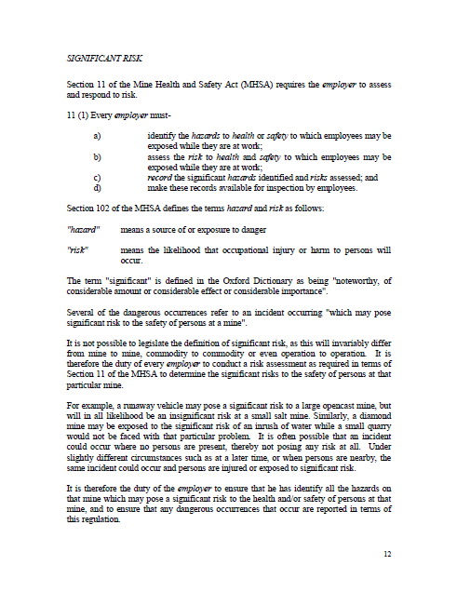
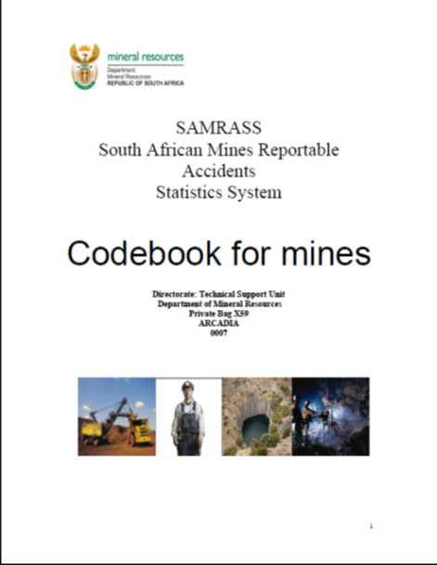
Has it Been Defined?

Slide 46
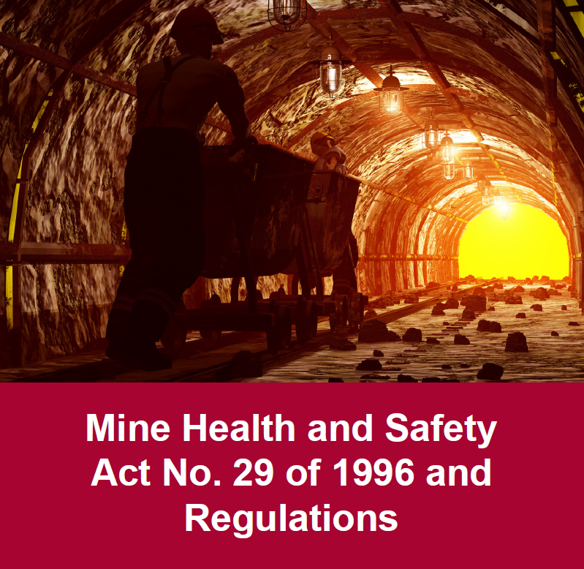
Significant Risk According to SAMRASS & MHSA
The term "significant" is defined in the Oxford Dictionary as being "noteworthy, of considerable amount or considerable effect or considerable importance".
“risk” means the likelihood that occupational injury or harm to persons will occur
“It is not possible to legislate the definition of “significant risk”, as this will invariably differ from mine to mine, commodity to commodity or even operation to operation. It is therefore the duty of every employer to conduct a risk assessment as required in terms of Section 11 of the MHSA to determine the significant risks to the safety of persons at that particular mine.”
SAMRASS
MHSA SEC. 102
SAMRASS

Slide 47


Significant Risks of TMM Collisions
The worst case consequence of any vehicle to vehicle (V-V) and vehicle to pedestrian (V-P) interaction is a fatality irrespective of the speed of the vehicle(s).
CONSEQUENCE ≥ HIGH
Unless prevented, it can be agreed that there will be a “noteworthy” likelihood that occupational injury or harm to persons will occur as a result of V-V or V-P collision.
SIGNIFICANT RISK OF TMM COLLISIONS

Slide 48
What are the implications if the mine don’t want to introduce other reasonably practicable measures to prevent TMM
All the TMMs operating where there is a significant risk of collision must be fitted with:
Auto detection and
effective warning to both operators/operator and pedestrian when a collision is imminent and
provide the operator with time to take appropriate action and
have an auto slow and stop ability to prevent a potential collision when the operator/pedestrian does not take the appropriate action and
Have a fail to safe function without human intervention
CPS
L9

